Slide 1
Store Data Analysis through Excel
Dhruv Verma

Slide 2
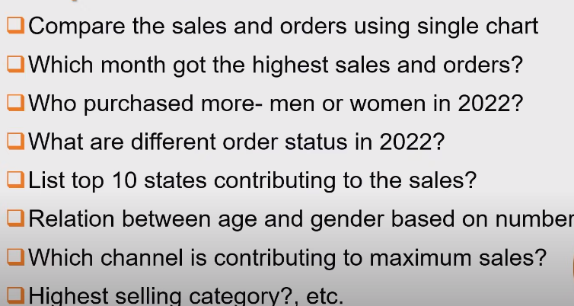
Business Problems

Slide 3
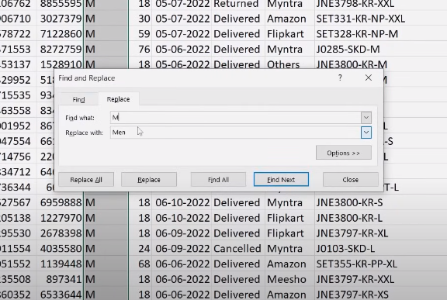
Data Cleaning
Here We are Rectifying Duplicate data with different Variables

Slide 4
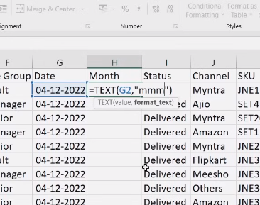
Data Processing
We are Creating Additional Column for Easier Analysis in the Later Steps

Slide 5
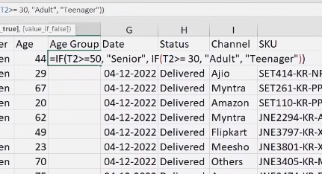
Data Processing
Binning the Age Column into Age Groups for Easier Visualisation Purpose

Slide 6
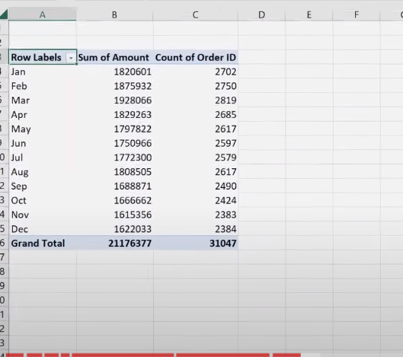
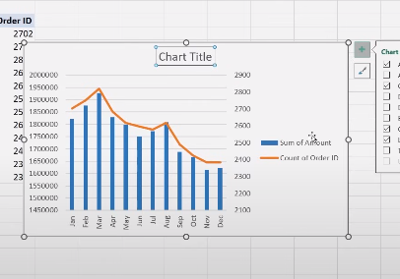
Data Analysis through Pivot Charts

Slide 7
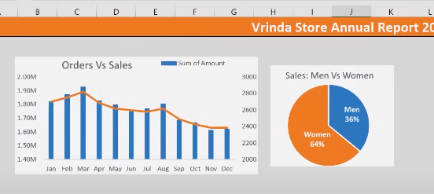
Initiating Dashboard

Slide 8
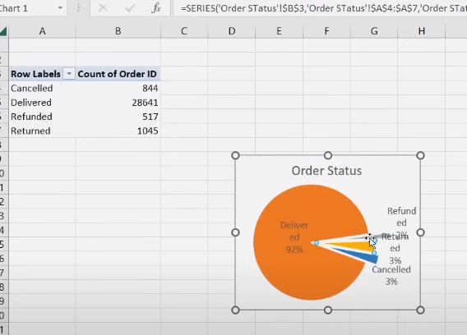
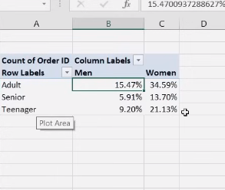
Necessary Metrics

Slide 9
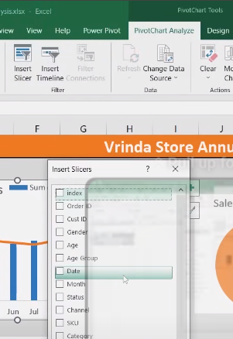
Slicers/Filters of Dashboard for Interactive Nature
Adding Global Slicers/ Filter of Different Key Features Based for More Interactive Nature allowing the Stakeholders to Take Full Use of Data and Gain Valuable Insights

Slide 10
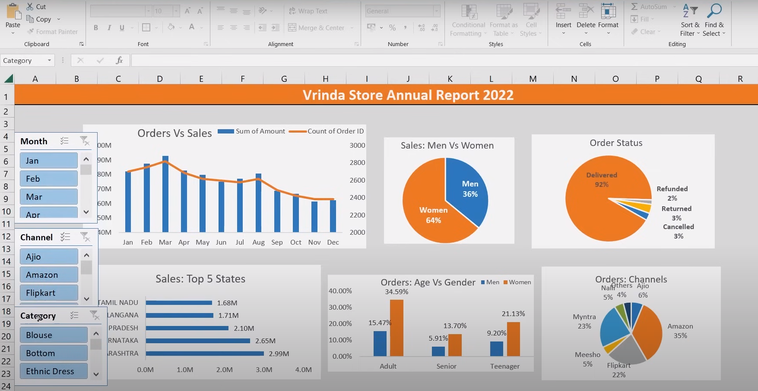
Final Dashboard

Slide 11
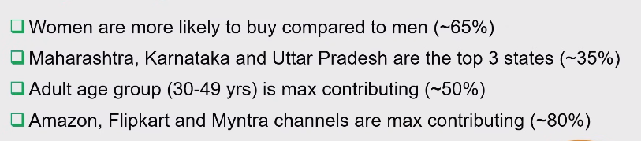
Insights Generated

